Slide 1
OLLI Mason
A Return Plan
2021 OLLI Town Hall
Jennifer L. Disano
Executive Director

Slide 2
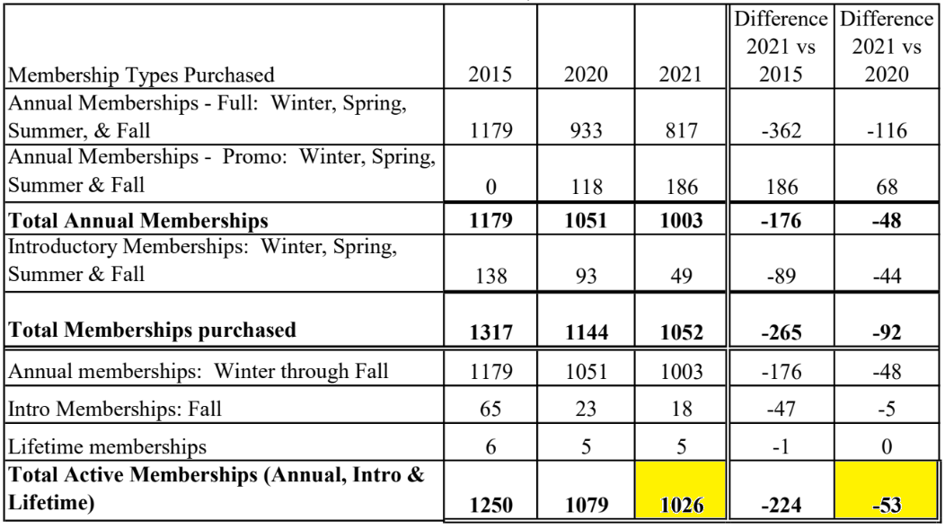
Membership
Total Membership 1026

Slide 3
3 Modes of Program Delivery
Zoom Only
  Dedicated Zoom offerings for every class session
In Person Only
  Fairfax, Reston and Loudoun classrooms
In Person with a Zoom component
  Fairfax and Loudoun classrooms are available to support hybrid offerings
  Reston is under evaluation

Slide 4
Health and Safety
All OLLI Mason members, teachers, staff, and visitors must show proof of vaccination before coming to any OLLI Mason campus. In the coming weeks, OLLI will announce special Zoom sessions in which you will have the opportunity to show proof of vaccination and be verified to attend classes. Please look for these announcements in OLLI communications or the Daily email. Please do not send in copies of your vaccination card or other documentation.
All OLLI Mason members, teachers, staff, and visitors must complete the Mason Health Check In before each campus visit. The “GMU Daily Check in” will be included on the OLLI Daily email. You must show a GMU Daily Check in Green pass to the class liaison or staff in order to enter the classroom.
OLLI Mason members, teachers, staff, and visitors must wear a mask indoors.
No food or drink in any classrooms with the exception of a water bottle for the instructor only. Beverages and food items allowed in outdoor spaces only.

